Slide 1
March Madness Week 1 Math Corners and Constructed Response

Slide 2
Math Corner-Rounding
Look at the number below. 22
What ten is this number closest to? Create a number line to prove your answer.
Round the numbers 35, 42, and 58 to the nearest ten.
Use the chart below to represent the number in multiple ways?
Represent the Number using only this Place Value
# | Hundreds | Tens | Ones

Slide 3
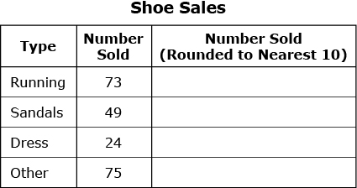
Constructed Response Rounding
Part A Round the number sold of each type of shoe to the nearest ten. List your answers in the same order as given in the table. Part B The owner of the store said the number of running shoes and sandals together was more than the number of dress and other types of shoes together. Explain why the owner’s statement does or does not make sense.

Slide 4
Math Corner-Rounding
Ken had 49 comic books.
He bought 12 more.
1. About how many comic books does Ken now have?
2. Show how to CHECK you’re your using the opposite operation.
3. How can you prove your thinking using a number line?

Slide 5
Constructed Response-Rounding
Part A
How can number lines be used as a tool to help round numbers?
Part B
Draw a number line to 100 counting by tens.
Part C
Draw a number line to 1000, counting by hundreds.
Part D
Select 4 two-digit numbers to put on the number line. Round to the nearest ten.
Select 4 three-digit numbers to put on the number line. Round to the nearest hundred.

Slide 6
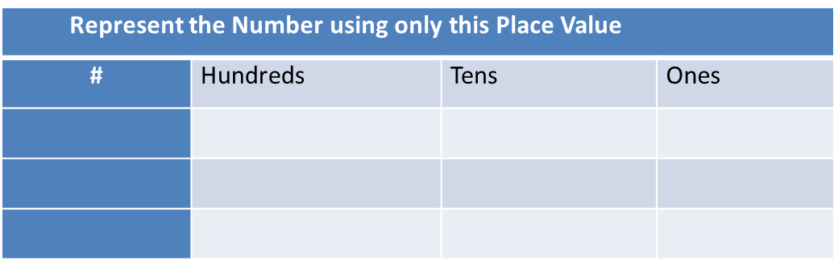
Math Corner-Rounding
Look at the number below. 328
What hundred is this number closest to? Create a number line to prove your answer.
Round the numbers 486, 220, and 753 to the nearest hundred.
Use the chart to represent these numbers in multiple ways.

Slide 7
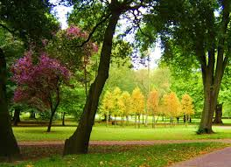
Constructed Response-Rounding
A large park has 58 trees and 245 flowers. Part A Round the number of trees to the nearest 10. Show your thinking. Part B Round the number of flowers to the nearest 100. Show your thinking.
Part C
What is the total number of trees and flowers in the park? Show your work. Part D The park also has benches. The number of benches rounded to the nearest 10 is 30. How many benches could possibly be in the park?

Slide 8
Math Corner-Rounding
Look at the number below. 461
What hundred is this number closest to? Create a number line to prove your answer.
Round the numbers 236, 370, and 453 to the nearest hundred.
Use the chart below to represent these numbers in multiple ways?

Slide 9
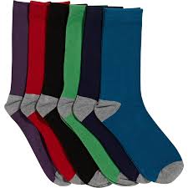
Constructed Response-Rounding
A Boy Scout Troop collected pairs of socks for the homeless.
Part A
If they collected 92 socks on Monday, about how many did they collect? (Round to the nearest ten.)
Part B
They collected 110 more on Tuesday. What is their new total? About how many did they collect? (Round to the nearest hundred.)
Part C
These are the Scout’s totals for the next 3 days: 265, 330, 698. Round each number to the nearest ten and nearest hundred.

Slide 10
Math Corner-Rounding
At Chuck E. Cheese, Frank had 325 game tokens. He gave Paul 157 tokens.
How many tokens does Frank have left?
What would your answer be rounded to the NEAREST HUNDRED?
Draw a number line to prove your thinking.
How would your answer change if you rounded to the nearest 10

Slide 11
Constructed Response-Rounding
At the movie theater, 229 movie tickets were sold in the month of June. 428 tickets were sold in July.
Part A
Round each number to the nearest 10.
Part B
Round each number to the nearest 100.
Part C
How many more tickets were sold in July than in June?

Slide 12
Multiplication

Slide 13
Math Corner-Multiplication
There were 6 girls invited to a birthday party. Each girl will receive 6 party favors.
Show a model to represent these party favors.
How would the model look differently if there were only 4 girls at the party?

Slide 14
Constructed Response-Multiplication
Part A
How are multiplication and addition related? Write your own story problem and solve it using both multiplication and addition.
Part B
Corey has 40 blocks to give away. If he gives an equal amount to each of his friends, how many friends could he share the blocks with? How many blocks will each of his friends get?
Part C
A teacher wants to divide a class of 33 students into three equal groups. What expression could be used to calculate the size of each group? Explain your thinking using pictures, numbers, and
words.

Slide 15
Math Corner-Multiplication
There are four checkout lines at the grocery store. There are eight customers in each line.
How many people are waiting to pay for their groceries? Solve the problem two ways.

Slide 16
Constructed Response-Multiplication
The number is: 45
Part A
Explain how you would use repeated addition to reach this product.
Part B
What array model(s) could be used to represent this product.
Part C
Explain how skip counting represents your array. What would your number sentence look like?

Slide 17
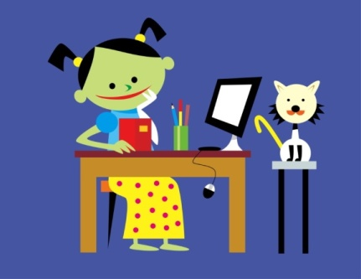
Math Corner-Multiplication
You have 20 students in your classroom. Draw a picture showing at least two different ways your teacher could arrange the desks. Explain your thinking using pictures, numbers, and words.
Progress Check…
There are 21 students in Mrs. Jackson’s class. Each student brought in 3 rocks for a class project. How many rocks in all did the students bring?
What equation can you use to check this problem?
45 ÷ ? = 9

Slide 18
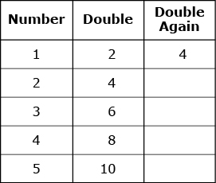
Constructed Response Multiplication
Ms. Brook is working on multiplication facts with her class.
She made this table to show how to double a number and then double it again.
Part A Ms. Brook says that anytime you double a number and then double it again, you get 4 times the first number. Copy and complete the table. Does Ms. Brook’s statement make sense? Explain your answer. Part B Ms. Brook doubled the number 11, then doubled it again to find the number of pencils she needs for her students. What is the result of doubling the number 11, then doubling it again? Show your work.

Slide 19
Math Corner-Multiplication
Solve two different ways.
Food Depot has six columns of potato chips. There are nine bags of chips on each row. How many bags of chips are there on display at Food Depot?
Create a model to demonstrate what the potato chip section at Food Depot looks like.
Challenge Question: What do rows and columns create?

Slide 20
Constructed Response-Multiplication
Jon works as a waiter. He places a bowl with dinner rolls on different tables. There are 7 dinner rolls in each bowl. He has 42 dinner rolls to serve.
Part A
How many tables did Jon place a bowl on? Show your work using a model.
Part B
Another waiter, Yasmine, places 60 glasses on the tables she is serving. She places an equal number of glasses on each table. How many tables could Yasmine serve and how many glasses would Yasmine place on each table? Show your work or explain your thinking.

Slide 21

Math Corner-Multiplication
The number is 12.
How many multiplication sentences can you create with a product of 12?
Challenge: Write a repeated addition sentence to match each multiplication sentence you create.

Slide 22
Constructed Response- Multiplication
Jordan bought 9 boxes of pencils. Each box had 6 pencils.
Part A
How many pencils did Jordan buy?
Part B
Jordan gave 12 pencils to her sister. Jordan then divided the rest of the pencils equally between 7 friends. Write an equation that can be used to find the number of pencils each friend got. Use a letter to stand for the number of pencils each friend got.
Part C
How many pencils did each friend get? Show your work or explain
your answer.

Slide 23
Time

Slide 24


Math Corner-Time
How is a clock like a number line?
2. If I started doing my homework at 4:30 and finished at 6:00, how long did it take me to finish? Show how to solve this problem using a number line and one other way.
Extra Practice:
What time do the clocks read below:

Slide 25

Constructed Response-Time
Part A
What tools can you use to understand elapsed time?
Part B
Which tool works best for you? Explain your reasoning.
Part C
Sam went to see a play. The clock above shows the time he arrived at the theatre. If the play starts at 6:45, how long does she have to wait?
Part D
Sam’s mom will come to pick him up at 8:30. How long is the play?

Slide 26
Math Corner-Time
Katie gets home from school at 3:15. She has an afternoon snack for 15 minutes, and does her homework for an hour. Then, she goes to soccer practice. What time does Katie leave home to go to soccer practice?

Slide 27

Time-Constructed Response
A shopper visits the restaurant. The clock shows the time the shopper entered the restaurant.
Part A
What time is on the clock?
Part B
The shopper stayed for 45 minutes. What time did the shopper leave? Show your work. Explain your answer.
Part C
Draw a clock to show the new time.

Slide 28
Math Corner-Time
Copy and fill in the missing places on this schedule for the Stockbridge Movie Theater.
Movie | Start Time | End Time | Duration
Alvin and the Chipmunks | 12:00 | 1:45
The Smurfs | 1:50 |  | 2 hours
The Muppets | 4:00 | 5:15
The Lion King |  | 7:00 | 90 minutes

Slide 29
Constructed Response-time
Tonya read 2 chapters of her AR book. She started reading at 8:30 and stopped reading 45 minutes later.
Part A
Use a strategy to explain the time Tonya stopped reading.
Part B
Explain the steps you used to prove your thinking.
Part C
How long would Tonya read if she stopped at 10:00? Use a number line to prove your thinking.

Slide 30
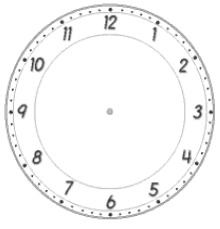
Math Corner-Time
Mrs. Smith’s class is leaving for a field trip at 9:25. It will take an hour to get there on a bus. Next they will take a tour that lasts an hour and a half. They will eat lunch for 30 minutes and then take the hour bus ride back to the school. Draw a clock on your paper to show what time Mrs. Smith’s class will return from their field trip.

Slide 31
Constructed Response-Time
Vivian is going on a train ride with her grandmother.
Part A
When they leave the house it is 3:15. It will take them 1 hour and 40 minutes to get to the train station. What time will they arrive?
Part B
The train ride lasts for 2 and a half hours. What time will the train ride end?
Part C
Write your own example of a start and ending time where the elapsed time is 2 ½ hours long.

Slide 32

Math Corner-Time
Lester watched a movie at his friend’s house. The movie started at 2:15 p.m. and lasted 2 hours and 45 minutes. What time did the movie end?
2. Use a number line to prove your thinking.
3. Draw a clock to represent Lester’s arrival time and when the movie ended.

